Slide 1
Courcera - Machine Learning 1 Week
최승완

Slide 2
Machine Learning
What is Machine Learning?
“Field of study that gives computers the ability to learn without being explicitly programmed”
Form. Arthur Samuel
Machine Learning Definition(Form. Tom Mitchell)
E ▶ Experience datasets for learning
T ▶ Problem
p ▶ Performance measure of T
※ Algorithm to improve performance 'p' of problem 'T' using Experience 'E'
Notes:
머신러닝 설명

Slide 3
Machine Learning
What is learning?
regression problem
Supervised Learning
Machine Learning
classification
Unsupervised Learning
clustering
Notes:
머신러닝 설명

Slide 4
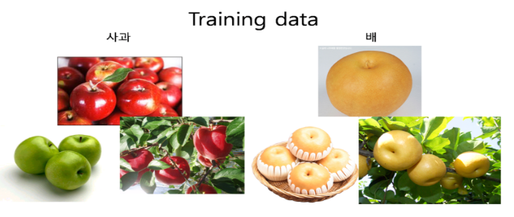
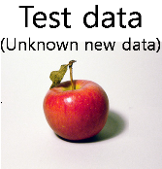
Supervised Learning
Supervised Learning ?
How to predict the correct answer to a new one given the data that knows the correct answer.
- Given information on Output ‘Y’ for Input ‘X’(Training Data)
Notes:
지도학습 설명 -> 지도학습은 데이터에 따라 두가지 문제로 나뉨

Slide 5
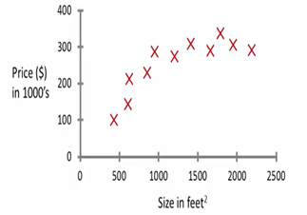
Supervised Learning
Supervised Learning ?
How to predict the correct answer to a new one given the data that knows the correct answer.
- Given the information of Output ‘Y’ for Input ‘X’(Training Data).
EX) Housing price prediction
- Predict the prices according to the size of the house
Regression

Slide 6
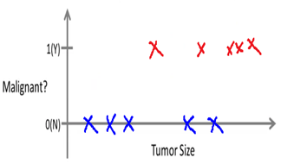
Supervised Learning
Supervised Learning ?
How to predict the correct answer to a new one given the data that knows the correct answer.
- Given the information of Output ‘Y’ for Input ‘X’(Training Data).
EX) Breast cancer(malignant, benign)
- Predict the malignant tumor according to the size of the tumor
Classification

Slide 7
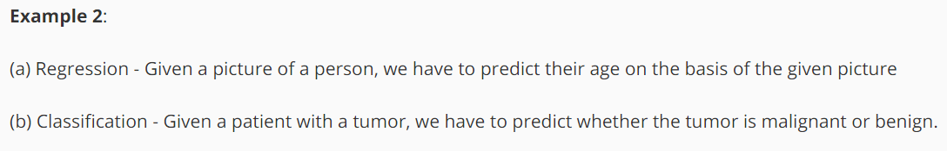
Supervised Learning
What difference on Regression to classification?
Regression - Output information age(Y) is continuous.
- age = {1,2,3,4……88,…,99}
Classification - Output information malignant or benign is Discrete.
- malignant = {Ture or False}, {1,0}

Slide 8
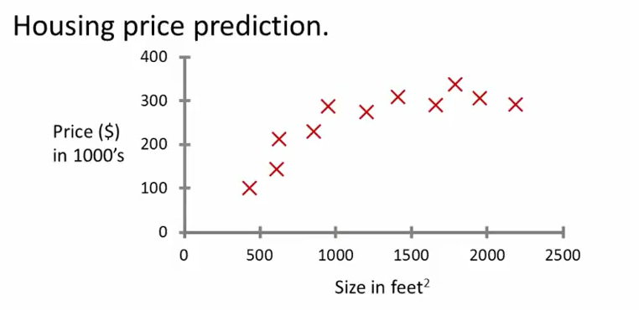
Regression Problem
Regression Problem (Continuous Output)
Solution : Create a model representing training data to predict the output.
- Create a model H(x)
- H(input ‘X’) → Continuous Output
x=1000 , y=220
$$h_{Θ}\left(x\right)=Θ_{0}+Θ_{1}x$$

Slide 9
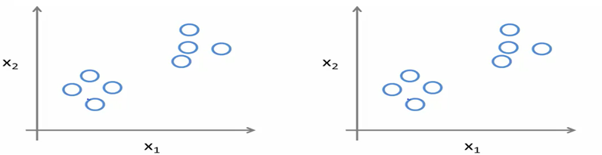
Unsupervised Learning
Unsupervised Learning ?
How to how to organize data when given information that can not distinguish data.
Clustering

Slide 10
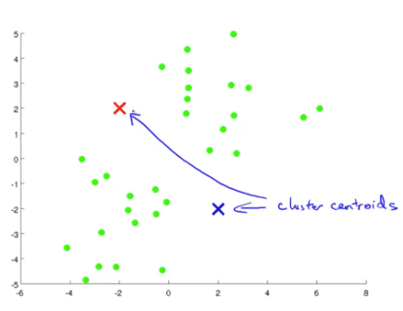
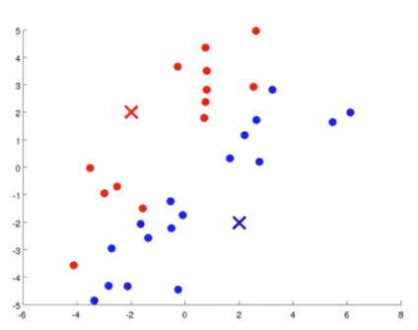
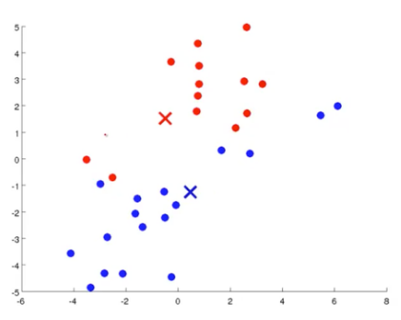
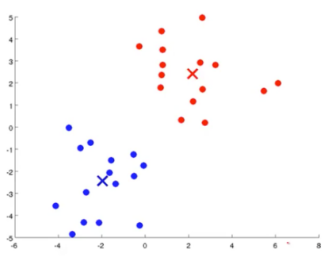
Unsupervised Learning
How to clustering?
Goal : Clustering similar features in Training Data.
- EX) K-Means Algorithm

Slide 11
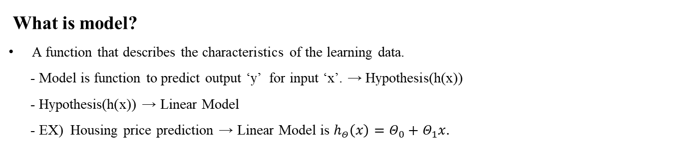
Model
What is model?
A function that describes the characteristics of the learning data.
- Model is function to predict output ‘y’ for input ‘x’. → Hypothesis(h(x))
- Hypothesis(h(x)) → Linear Model
- EX) Housing price prediction → Linear Model is $h_{Θ}\left(x\right)=Θ_{0}+Θ_{1}x.$
$$h_{Θ}\left(x\right)=Θ_{0}+Θ_{1}x$$
Linear Regression

Slide 12
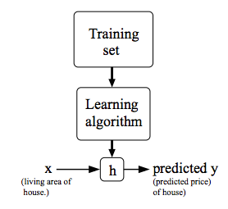
Linear Regression
Linear Regression Problem
Solution
Input training data set.
Learning through any algorithm.
A function generate that describes the characteristics of the learning data.
The hypothesis Predicts the output ‘y’ for input ‘x’

Slide 13

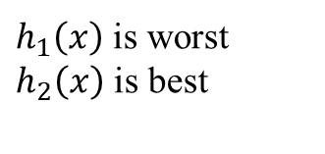

Cost Function
What is Cost Function?
Similarity between Training data and hypotheses(h(x)).
If when Similarity value is high, Cost function value is low → Best
If when Similarity value is low, Cost function value is high → worst
Y
4
3
2
1
$$h_{1}\left(x\right)$$
$$h_{2}\left(x\right)$$
$h_{1}\left(x\right)$ is worst
$h_{2}\left(x\right)$ is best
1 2 3 4 5 X

Slide 14
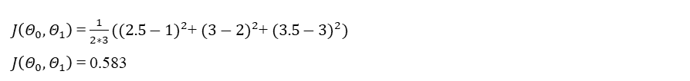





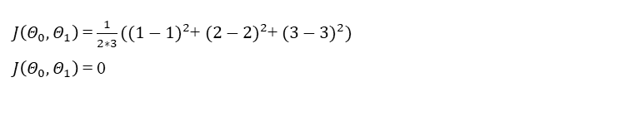
Cost Function
How to calculate Cost Function?
We use the difference between hypothesis function and training data.
$$J\left(Θ_{0},Θ_{1}\right)=\frac{1}{m}\sum_{i=1}^{m}{{(h_{Θ}\left(x^{i}\right)−y^{i})}^{2}}$$
Training Data
X | Y
1 | 1
2 | 2
3 | 3
1. $h_{1}\left(x\right)=Θ_{0}+Θ_{1}x$
${ Θ}_{0}$=2 , $Θ_{1}$=0.5
$J\left(Θ_{0},Θ_{1}\right)$ = $\frac{1}{2∗3}({(2.5−1)}^{2}$+ ${(3−2)}^{2}$+ ${(3.5−3)}^{2})$
$J\left(Θ_{0},Θ_{1}\right)$ = 0.583
Y
4
3
2
1
$$h_{1}\left(x\right)$$
$$h_{2}\left(x\right)$$
2. $h_{2}\left(x\right)=Θ_{0}+Θ_{1}x$
${ Θ}_{0}$=0 , $Θ_{1}$=1
$J\left(Θ_{0},Θ_{1}\right)$ = $\frac{1}{2∗3}({(1−1)}^{2}$+ ${(2−2)}^{2}$+ ${(3−3)}^{2})$
$J\left(Θ_{0},Θ_{1}\right)$ = 0
1 2 3 4 5 X

Slide 15

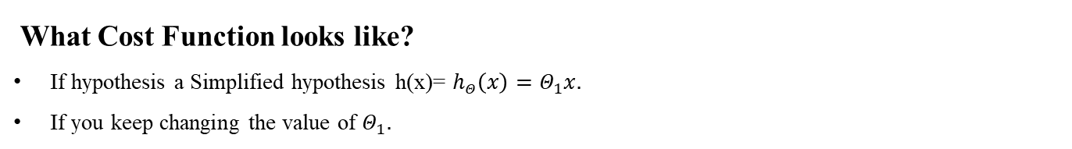

Cost Function
What Cost Function looks like?
If hypothesis a Simplified hypothesis h(x)= $h_{Θ}\left(x\right)=Θ_{1}x.$
If you keep changing the value of $Θ_{1}.$
$Θ_{0}$=0 , $Θ_{1}$=1 $→J\left(Θ_{1}\right)$ = 0
$Θ_{0}$=0 , $Θ_{1}$=0.5 $→$ $J\left(Θ_{1}\right)$ = 0.583
$Θ_{0}$=0 , $Θ_{1}$=1.5 $→$ $J\left(Θ_{1}\right)$ = 0.583
：
：
$$J\left(Θ_{1}\right)$$
4
3
2
1
-1 -0.5 0.5 1 1.5 2 $Θ_{1}$
Notes:
세타에 따라 어떻게 변하는지 코스트함수의 그래프로 이해

Slide 16

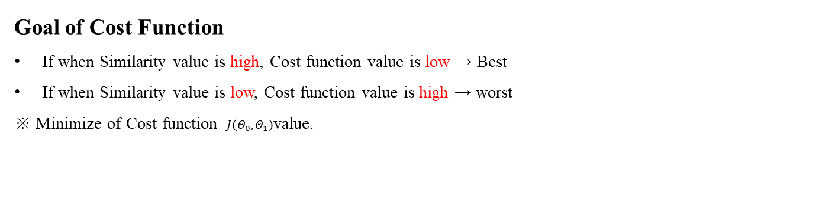

Cost Function
Goal of Cost Function
If when Similarity value is high, Cost function value is low → Best
If when Similarity value is low, Cost function value is high → worst
※ Minimize of Cost function $J\left(Θ_{0},Θ_{1}\right)$value.
$$J\left(Θ_{1}\right)$$
4
3
2
1
$$J\left(Θ_{1}\right)$$
-1 -0.5 0.5 1 1.5 2 $Θ_{1}$
Notes:
세타에 따라 어떻게 변하는지 코스트함수의 그래프로 이해

Slide 17
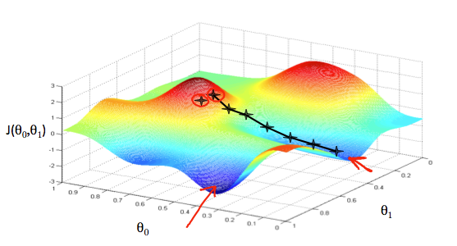
Gradient Descent
What is Gradient Descent?
- An algorithm that approaches the minimum or maximum of a function step by step,
proportional to the slope at the current position.

Slide 18

Gradient Descent
How to use Gradient Descent?
- An algorithm that approaches the minimum or maximum of a function step by step,
proportional to the slope at the current position.
Repeat until convergence
{
}
$α$ is leaning Rate
$θ_{j}:=θ_{j}−α\frac{∂}{{∂θ}_{j}}J\left(θ_{0}, θ_{1}\right) (for j=0 and j=1)$

Slide 19
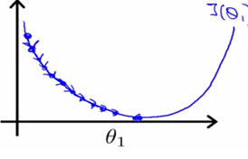
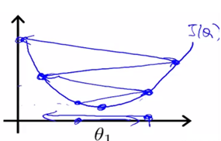

Gradient Descent
What is leaning Rate?
- Learning rate is a parameter that controls how much we are adjusting the weights of our with respect the gradient.
IF $α$ too small
IF $α$ too large
It is spend a lot of time to converge.
The value will diverge.

Slide 20
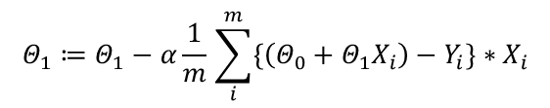

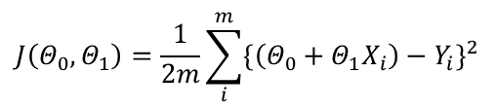
Gradient Descent
Gradient Descent of Cost Function
Repeat until convergence
{
}
Cost Function
Gradient Decent
Repeat until convergence
{
}
$θ_{j}:=θ_{j}−α\frac{∂}{{∂θ}_{j}}J\left(θ_{0}, θ_{1}\right) (for j=0 and j=1)$
$$Θ_{0}≔Θ_{0}−α\frac{1}{m}\sum_{i}^{m}{\{\left(Θ_{0}+Θ_{1}X_{i}\right)−Y_{i}\}}$$
$$J\left(Θ_{0},Θ_{1}\right)=\frac{1}{2m}\sum_{i}^{m}{{\{\left(Θ_{0}+Θ_{1}X_{i}\right)−Y_{i}\}}^{2}}$$
$$Θ_{1}≔Θ_{1}−α\frac{1}{m}\sum_{i}^{m}{\{\left(Θ_{0}+Θ_{1}X_{i}\right)−Y_{i}\}}∗X_{i}$$

